Slide 1
SER 334 A Session
SI Session
Thursday, February 15th 2024
7:00 pm - 8:00 pm MST

Slide 2
{
Agenda
Linking
Memory
Contiguous Memory
Fragmentation
Paging

Slide 3
SI Session Expectations
Thanks for coming to the SER 334 SI session. We have a packed agenda and we are going to try to get through as many of our planned example problems as possible. This session will be recorded and shared with others.
If after this you want to see additional examples, please visit the drop-in tutoring center.
We will post the link in the chat now and at the end of the session.
tutoring.asu.edu
Please keep in mind we are recording this session and it will be made available for you to review 24-48 hours after this session concludes.
Finally, please be respectful to each other during the session.

Slide 4

Interact with us:
Zoom Features
Zoom Chat
Use the chat feature to interact with the presenter and respond to presenter’s questions.
Annotations are encouraged

Slide 5
SER 334
Linking Libraries
Dynamic Linking
Static Linking
Only load if needed
Load everything at the start
+ save space
- making sure all libraries are linked
+ all libraries available
- need more space

Slide 6
Module 10 Sample
SER 334
Linking Libraries
Dynamic Linking
Static Linking
3. [Acuña] Consider the following scenario: you have spent several years developing an indie video game but have run out of funding, and have decided to release what you have completed to the public. Unfortunately your source code is rather messy and you only want to release binaries. Assume you want to maximize the lifetime of the game and who gets to play.
Would it be more appropriate to use a static or dynamic linking approach when doing the release build of your software? Explain.
Notes:
Dynamic - would allow for users to update components as they get updated in the future

Slide 7
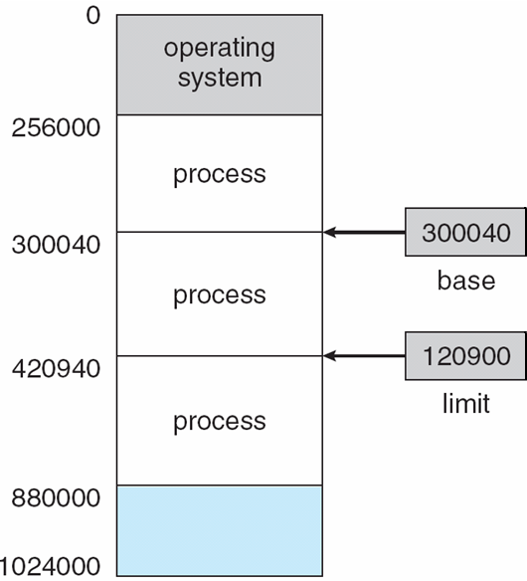
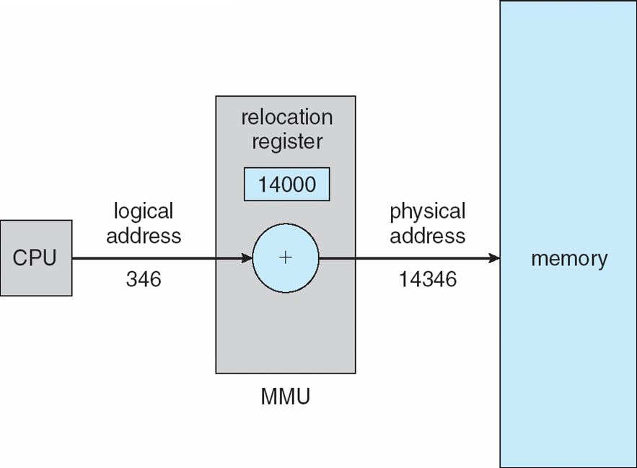
SER 334
Memory
MMU translates the logical address into the physical address
Type of Memory Allocation?
Contiguous
What would we call this?
Notes:
Physical is actual location in hardware
Logical is computed (start + offset)
A hole

Slide 8
Physical Memory
SER 334
Memory
DATA
Identify the EXTERNAL fragmentation
DATA
DATA
DATA

Slide 9
Physical Memory
SER 334
Memory
DATA
Identify the EXTERNAL fragmentation
DATA
DATA
Identify the INTERNAL fragmentation
DATA

Slide 10
Physical Memory
Tips to remember the difference?
SER 334
Memory
DATA
ROOM
Identify the EXTERNAL fragmentation
DATA
External = Rooms around
DATA
Internal = within Room
Identify the INTERNAL fragmentation
DATA

Slide 11
Physical Memory
SER 334
Memory
6. [Acuña] In a contiguous memory allocation system, would it make sense to initialize and place processes right next to one another to reduce fragmentation? Explain.
External = Rooms around
DATA
Internal = within Room
DATA

Slide 12
Physical Memory
SER 334
Segmentation
Prog
1
2
3
4

Slide 13
Physical Memory
SER 334
Segmentation
1
Possible EXTERNAL fragmentation
1
2
4
3
4
Possible INTERNAL fragmentation
3
2

Slide 14
Physical Memory
SER 334
What are these called?
Paging
Prog
1
FRAMES
2
3
What about these?
4
PAGES

Slide 15
UNIFORM PAGE SIZE (usually 4kb)
Physical Memory
SER 334
M
Paging
1
Logical Address
10 00
2
3
Pg #
Offset
4
M-N
N
Logical Address Size: 2^{M}
Page Size: 2^{N}

Slide 16
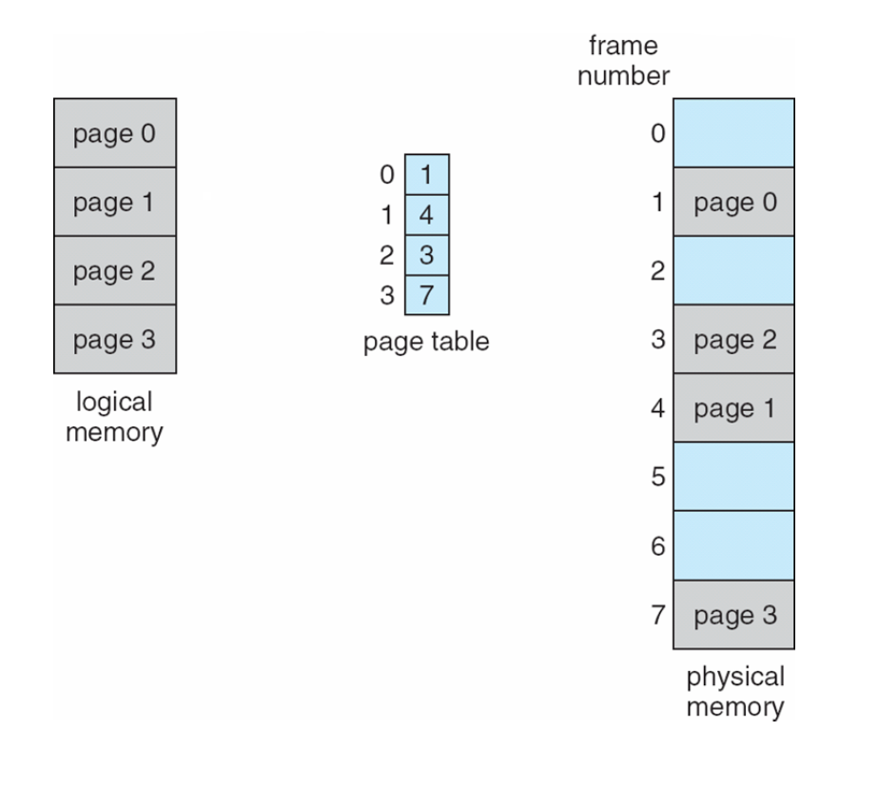
M
SER 334
Logical Address
Paging
Logical Address Size: 2^{M}
Page Size: 2^{N}
Pg #
Offset
M-N
N

Slide 17
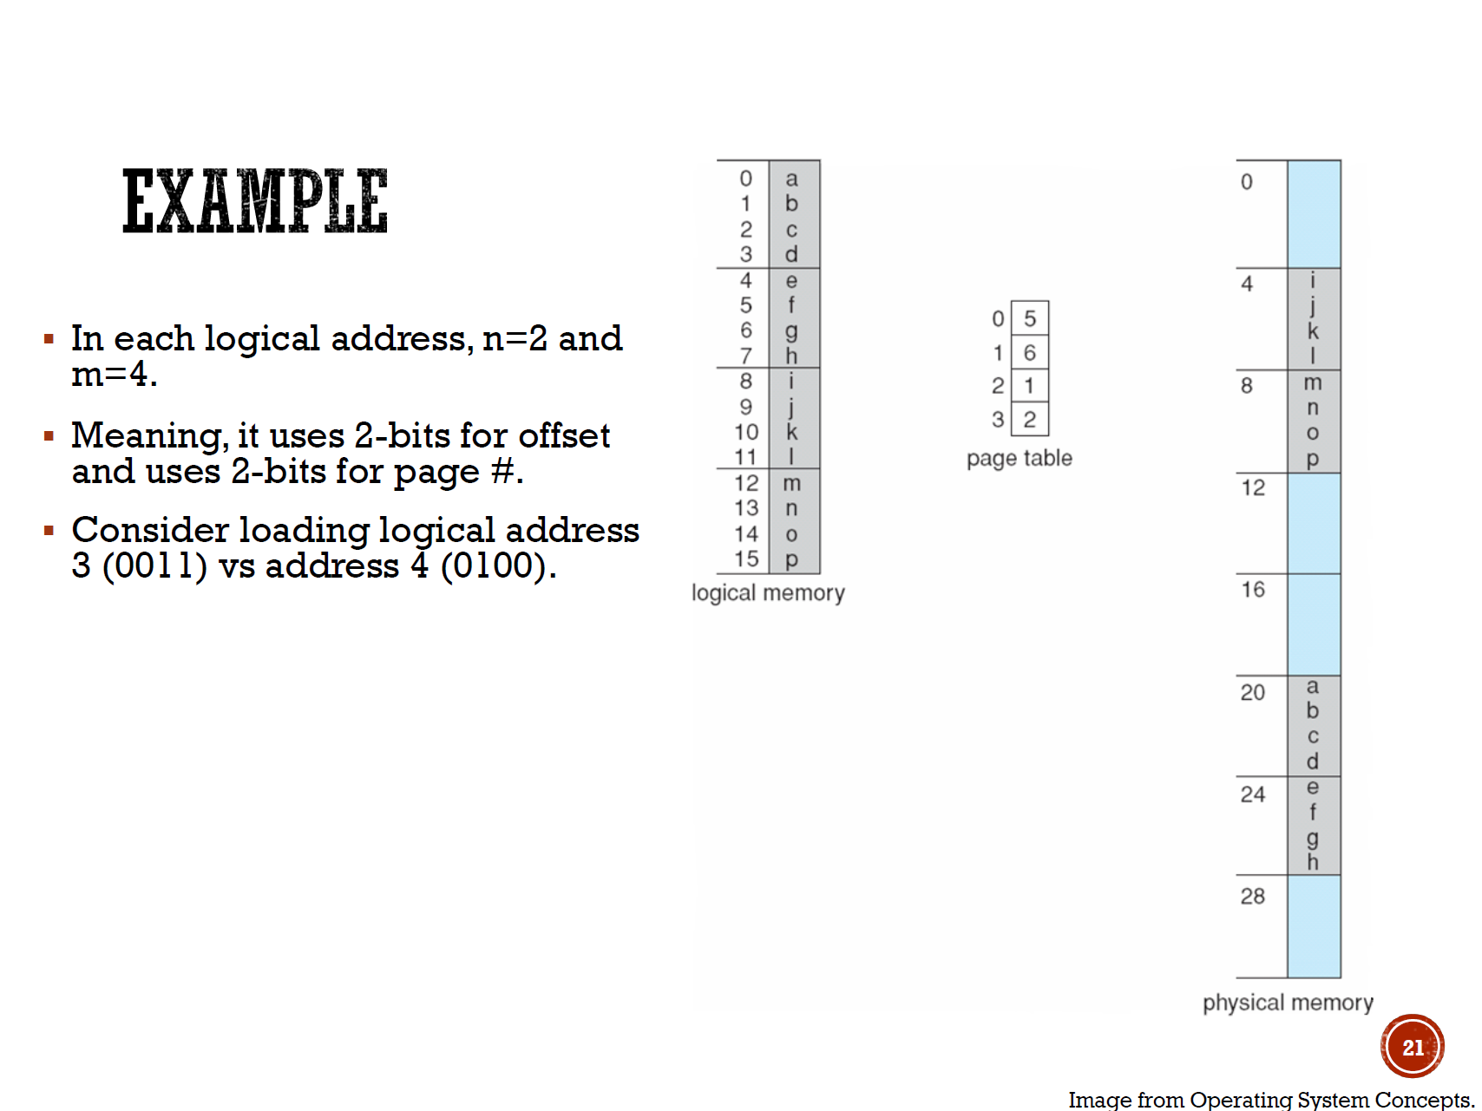
M
Frame * Page Size
SER 334
Logical Address
Paging
Logical Address Size: 2^{M}
Page Size: 2^{N}
Pg #
Offset
M-N
N
How do we obtain the correct frame number?
00
11

Slide 18
M
SER 334
Logical Address
Paging
Logical Address Size: 2^{M}
Page Size: 2^{N}
Pg #
Offset
M-N
N
00
11
01
00
11
01

Slide 19
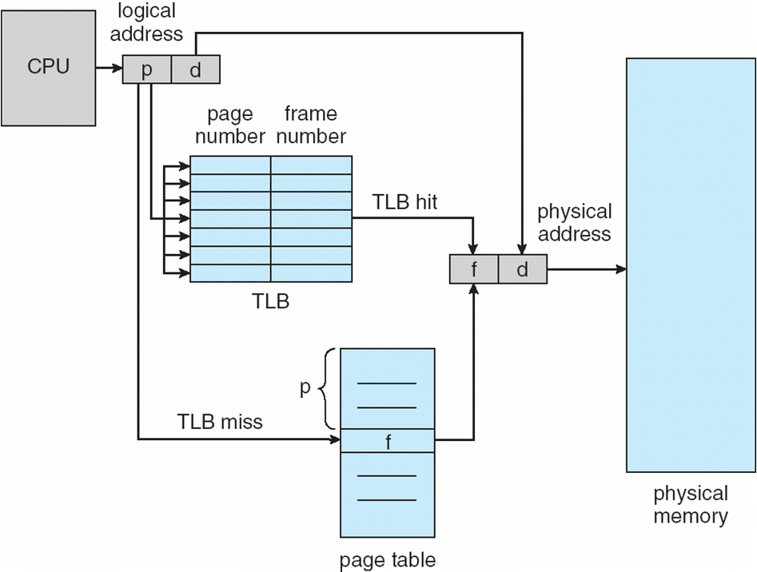
SER 334
Paging
🐢

Slide 20
Module 9 Sample
SER 334
Rate Monotonic
Scheduling Algorithms
process, period, burst
P0, 30, 15
Who goes first??
P1, 25, 15
1/30 = 0.033
1/25 = 0.04
P2 starts new period
P1 starts new period
10
20
30
40
50
60
Priority = 1/period

Slide 21
Module 9 Sample
SER 334
Rate Monotonic
Scheduling Algorithms
process, period, burst
P0, 30, 15
P1, 25, 15
1/30 = 0.033
1/25 = 0.04
P2 starts new period
P1 starts new period
10
20
30
40
50
60
P1
P 0
P1
P0
P1
Priority = 1/period
P1 usurps P0
Results in P0 missing deadline!

Slide 22
Module 9 Sample
SER 334
Rate Monotonic
Scheduling Algorithms
process, period, burst
Max CPU Load:
N(2^{1/N}-1)
2(2^{1/2}-1)=0.83
P0, 30, 15
P1, 25, 15
1/30 = 0.033
1/25 = 0.04
P2 starts new period
CPU Utilization: Burst/Period
15/30 = 0.5
P1 starts new period
CPU Utilization: Burst/Period
15/25 = 0.6
10
20
30
40
50
60
P1
P 0
P1
P0
P1
Priority = 1/period
P1 usurps P0
Results in P0 missing deadline!

Slide 23
SER 334
Scratch Space

Slide 24
Upcoming Events
SI Sessions:
Sunday, February 18th at 7:00 pm MST
Monday, February 19th at 7:00 pm MST
Sunday, February 25th at 7:00 pm MST - Q&A Session before Exam 3
Review Sessions:
Exam 3 Review: Thursday, February 22nd at 7:00 pm MST

Slide 25

Questions?
Survey:
http://bit.ly/ASN2324

Slide 26


More Questions?
Check out our other resources!
tutoring.asu.edu
1-
2-
Click on ‘Go to Zoom’ to log onto our Online Tutoring Center.
Click on ‘View the tutoring schedule’ to see when tutors are available for specific courses.

Slide 27
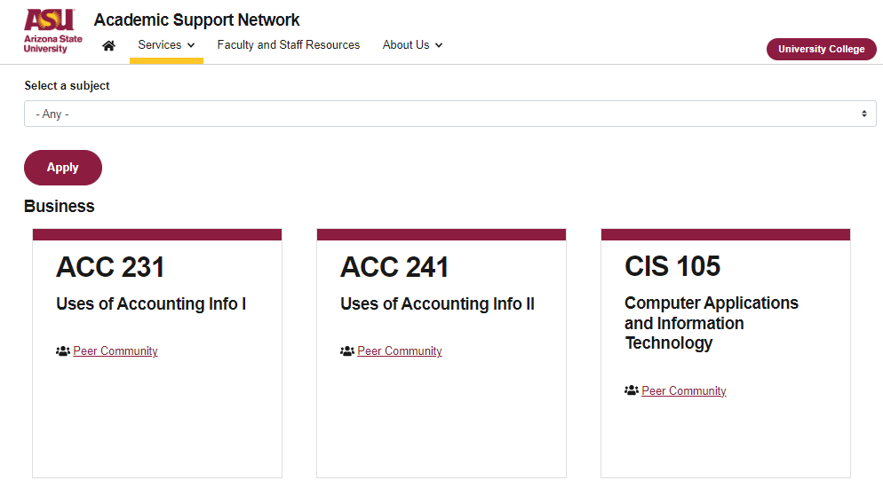

More Questions?
Check out our other resources!
tutoring.asu.edu/online-study-hub
Don’t forget to check out the Online Study Hub for additional resources!

Slide 28


Expanded Writing Support Available
Including Grammarly for Education, at no cost!
tutoring.asu.edu/expanded-writing-support
*Available slots for this pilot are limited

Slide 29
Additional Resources
Course Repo
Course Discord
BMP File Format (Wiki)
Linux Kernel API
Bootlin - Linux Cross Referencer
Dining Philosophers Interactive
Producer/Consumer Visual

